Slide 1
Political Database Modeling the 2016 Presidential Campaign
By:
SALMAN QURAISHI
AMIR HOSSAIN

Slide 2
Problem to be solved
To create a database modeling the 2016 Presidential Campaign. There is no such interactive, intuitive, and easy to use database. Thus our aim was to create such a database which can easily be interacted with.
Our first approach was to create a database by candidate, rather we realized after consulting with Professor Zhang, that any political issue exists without a candidate thus we decided to model accordingly.

Slide 3
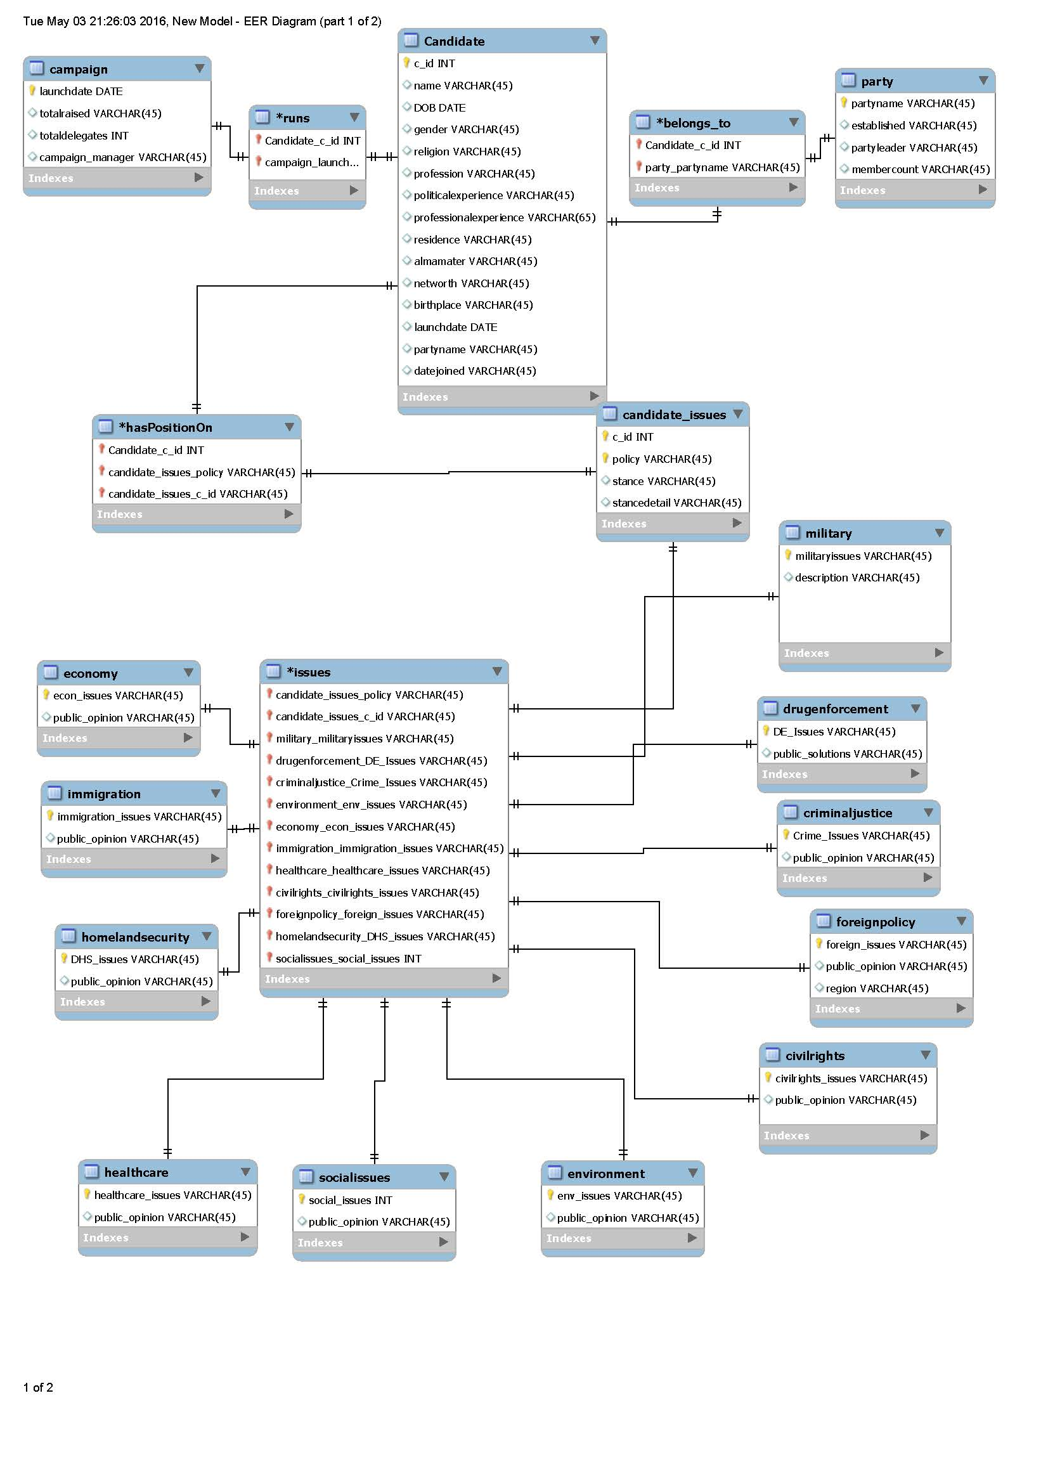
FINAL ERD

Slide 4
Contributions
Salman Quraishi – Early Development, Design Planning, Modeling, Final ERD, Research, Gathering Data, Grouping Data, SQL, Query Testing, Final Report
Amir Hossain – Pre-Development, Modeling ERD, First ERD, Research, Data Insertion/Inputting, Testing Relations, Project Finalization, Error Elimination.

